Slide 1
Computer Organization and Assembly Language
Week-03

Slide 2
Logistics Update
Instructor: Muhammad Usama
Email: m.usama@nu.edu.pk
Office:
Office Hours: Monday and Tuesday (09 am to 11 PM)
Lectures: 2 Lectures/week
Lab: 01 Credit
Grading Policy:
Assignments: 10%
Quiz: 20%
Mid-term exams: 25% (10 + 15)
CP: 5%
Final exam: 40%
Since COAL is a core course for the computer science program, as per NUCES policy the absolute grading willbe observed.
Reading material: (Soft copies of the material will be released before/after the class)
The elements of computing systems by Noam Nisam and Shimon Schocken 2nd Edition.
x86 Assembly language by Kip Irvin (Latest Edition)
Assembly Language Notes by Belal Muhammad Hashmi and Junaid Haroon
System on Chip (SoC) Material from various sources
Updates:
Reading material updated on the Google classroom.
Quiz 2 will be on 2nd lecture of this week.
Material will be from 1st lecture till the end of the first lecture.
Please get nasm, dosbox, AFD sorted by the end of this week as the first set of assignment questions will be released early next week.

Slide 3
Agenda
Data Declaration
Direct Addressing
Register Indirect Addressing
Register + Offset Addressing
Segment Association
Quiz 2

Slide 4
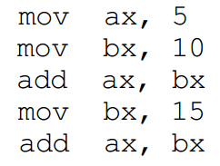

Can we write a useful program using immediate operands?
Immediate Operand
Opcode for Immediate Operands:
mov ax, 5 ===> B80500
mov bx, 10 ===> BB0A00
Data Declaration
Define Byte (8 bits)
Define word (16 bits)
Define double word (32 bits)
Define quadword (64 bits)
Label
To refer to this variable later in the program, we need the address occupied by this variable. The assembler is there to help us. We can associate a symbol with any address that we want to remember and use that symbol in
the rest of the code. The symbol is there for our own comprehension of code. The symbol is known as label.

Slide 5
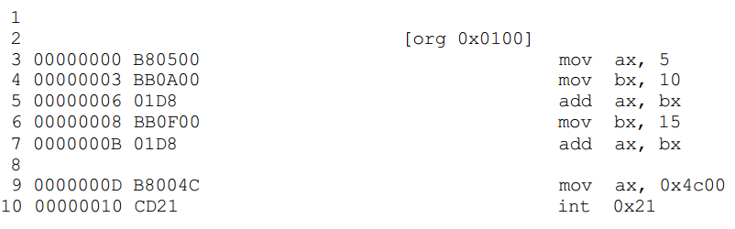
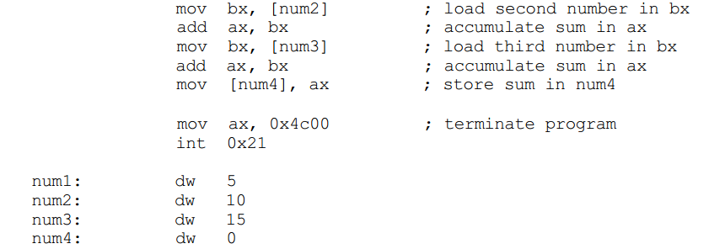
Chellenge Question
What should be the opcodes of the instructions in the red zone?
Check the opcodes in your lab work

Slide 6
Using memory variables to write a better code

Slide 7
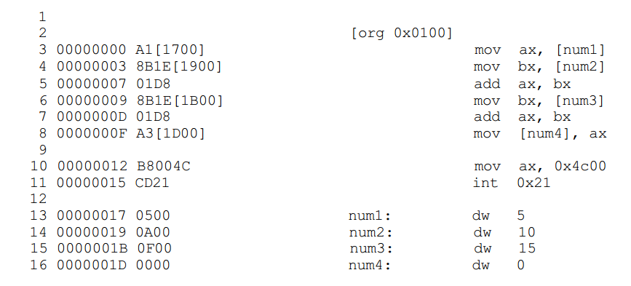
Lets take a closer look on the direct addressing
The first instruction of our program has changed from B80500 to A11700.
The opcode B8 is used to move constants into AX, while the opcode A1 is used when moving data into AX from memory.
Insted of using four labels can we use one, just like we do in high-level languages?

Slide 8
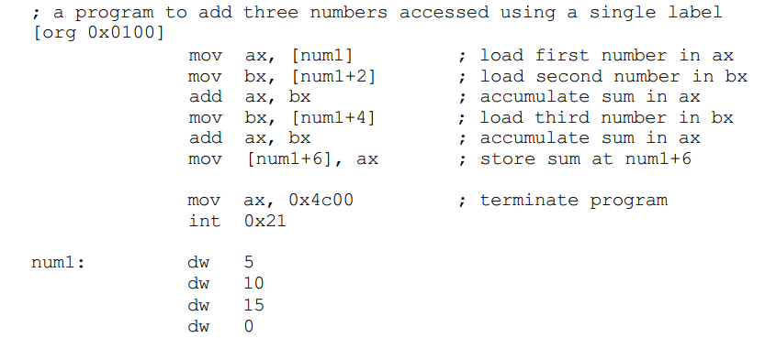
Rather than using four labels can we use one
Since dw is 2 bytes so we can also use num1+x to access data.
Another way of writing it!!
Label is just an indication and num1 will be translated into a number.

Slide 9
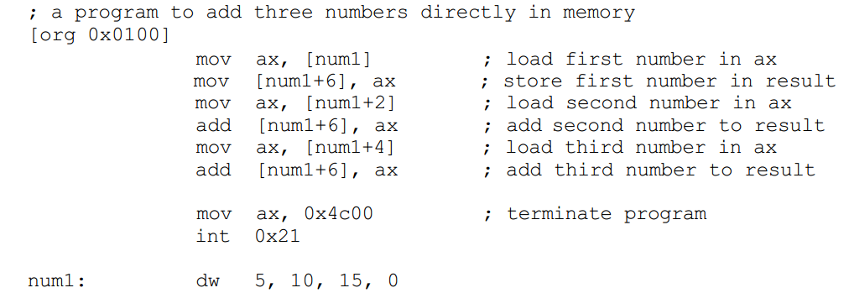
Using memory to register for addressing
Memory location where we want our result.
Program ended here and we can have data after that. (Logical window)
Run this code on your simulator and see the com file on your debugger and see the change in the opcodes!!!

Slide 10
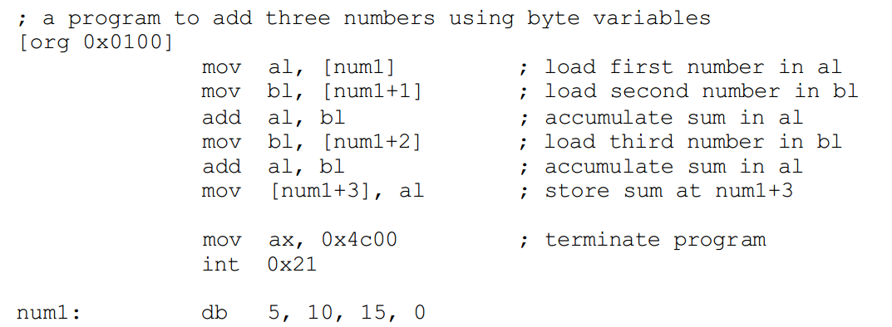
Size Mismatch Issue
dw
Be careful about the data label and size of the data input

Slide 11
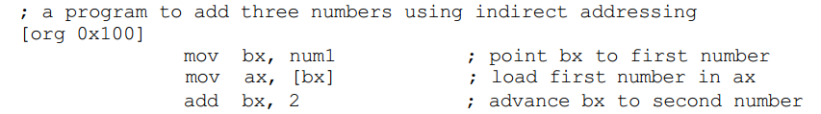
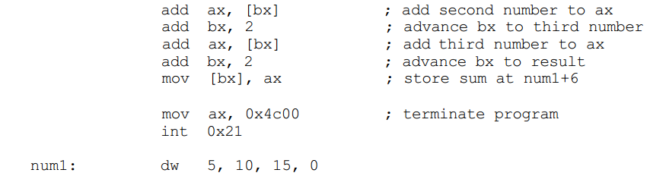
Register Indirect Addressing
What if we want to add hundrad numbers instead of three numbers?
Ability to change address repeatedly
A way to repeat the “add” instruction 100 times.
Ability to change address repeatedly
Moving to next address that is two byte away in the memory
Now bx has the address of next word (10) in the num1:.
Since num1 is not in square brackets it means it means only the address of the ``num1” will be moved to bx register not the contents of the num1.
There are four registers in initial intel architecture that can hold address of data and they are BX, BP, SI, and DI. There are minute differences in their working which will be discussed later. For the current example, we will use the BX register.

Slide 12
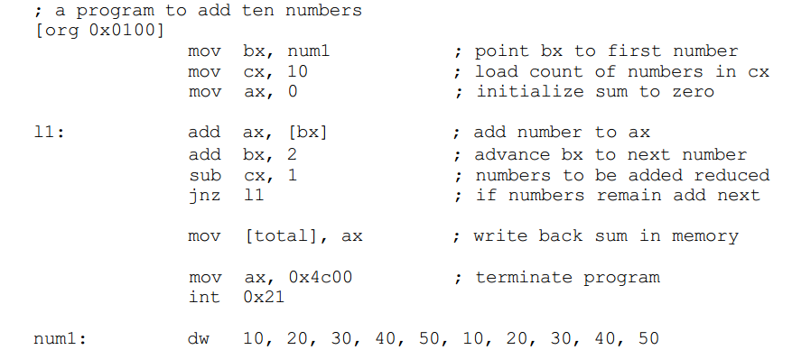
Register Indirect Addressing
What if we want to add hundrad numbers instead of three numbers?
Ability to change address repeatedly
A way to repeat the “add” instruction 100 times.
A way to repeat the “add” instruction 100 times and when to terminate the program.
JNZ (Jump if not zero)
Jump to the location defined by lable “l1” if the “ZERO FLAG” is not set.
“cx” contains the loop counter.
“cx” register is used here as a counter.

Slide 13
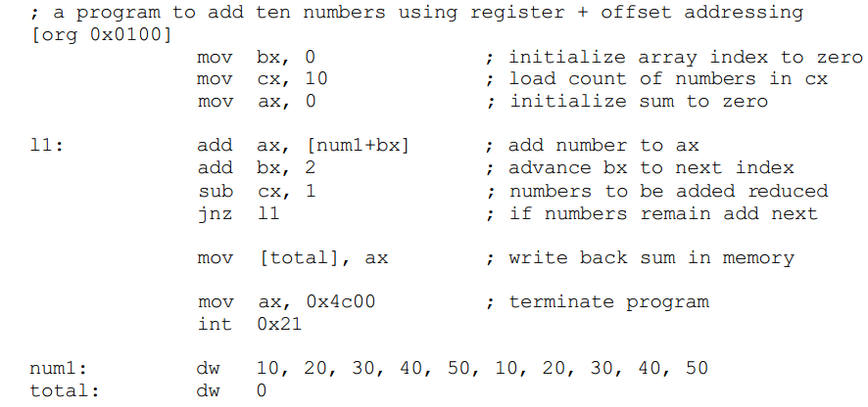
Register + Offset Addressing
Combination of direct and indirect addressing

